Slide 1

Technical
Presented by: John Bellamy

Slide 2
Resources
Snowflake inference service container. See notes in github repo: johnb340/xgboost-wine-snowflake:v1
Github: https://github.com/johnlbellamy/snowpark_ml/tree/master

Slide 3

Agenda
Part I Data Engineering:
Diagram
Tables
Solution Overview
Part II E2E ML On Snowflake:
Overview
Data Engineering
Exploratory Analysis & Feature Selection
Transformation/Model Pipeline & Model Repo
Inference Endpoint
Conclusion
QA
Backups

Slide 4
Part I

Slide 5
Solution Overview

Slide 6
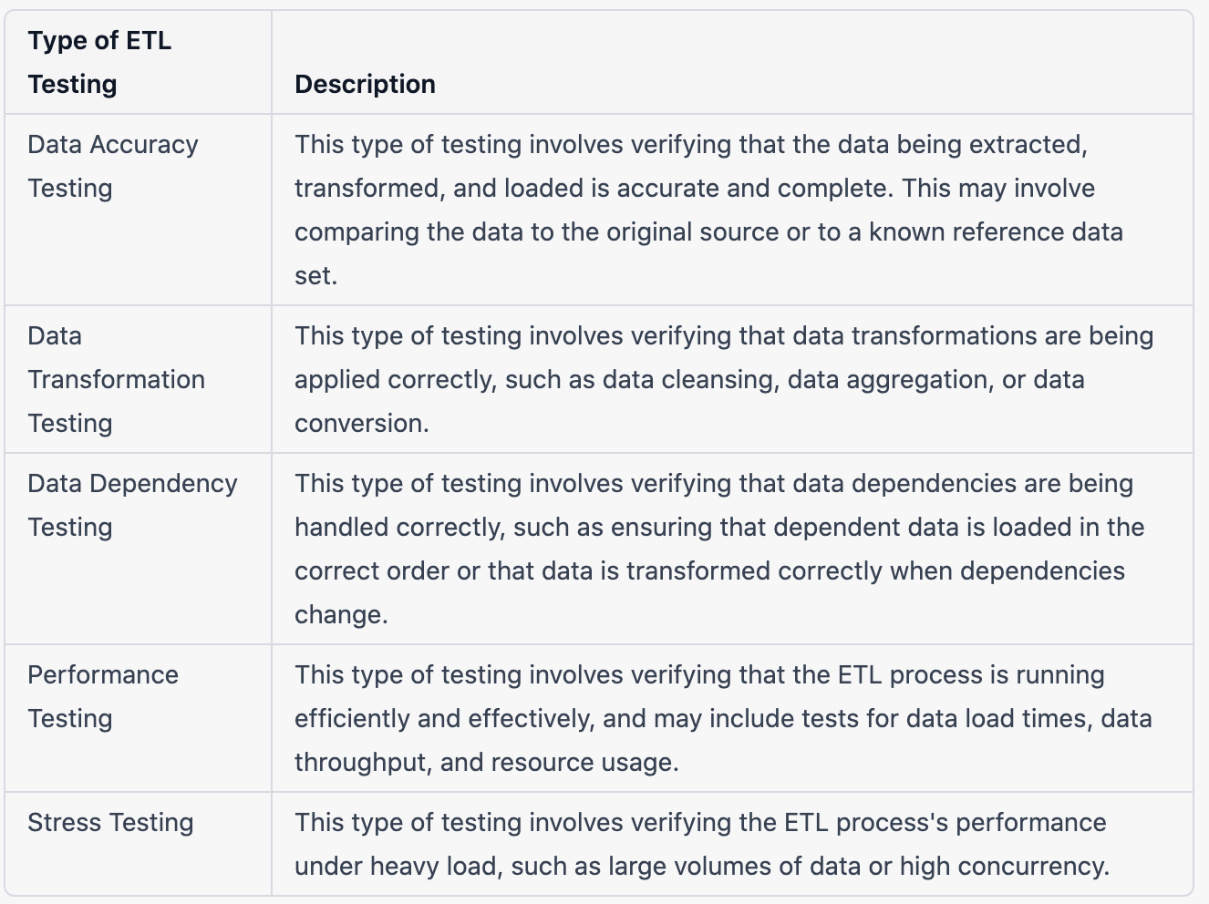
Solution Overview: Testing
Source: LinkedIn Learning and Anshul Thareja

Slide 7
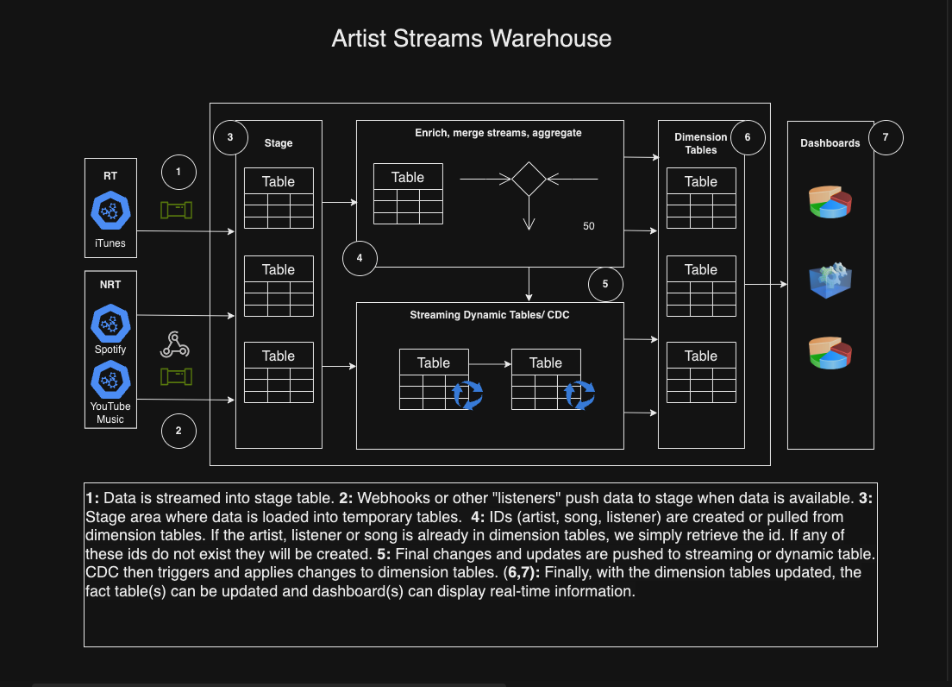
Architecture

Slide 8
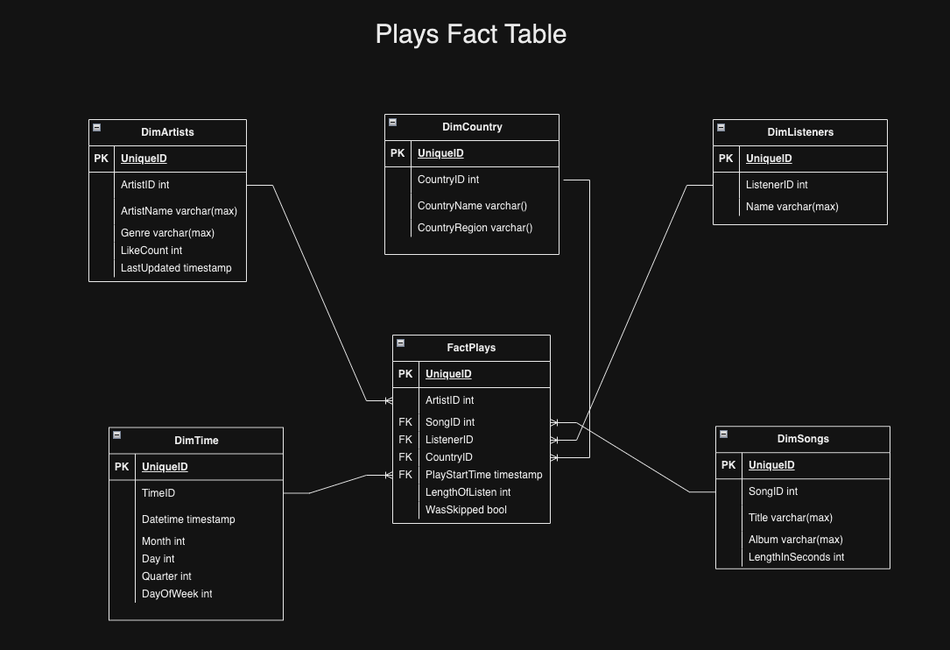
Tables

Slide 9
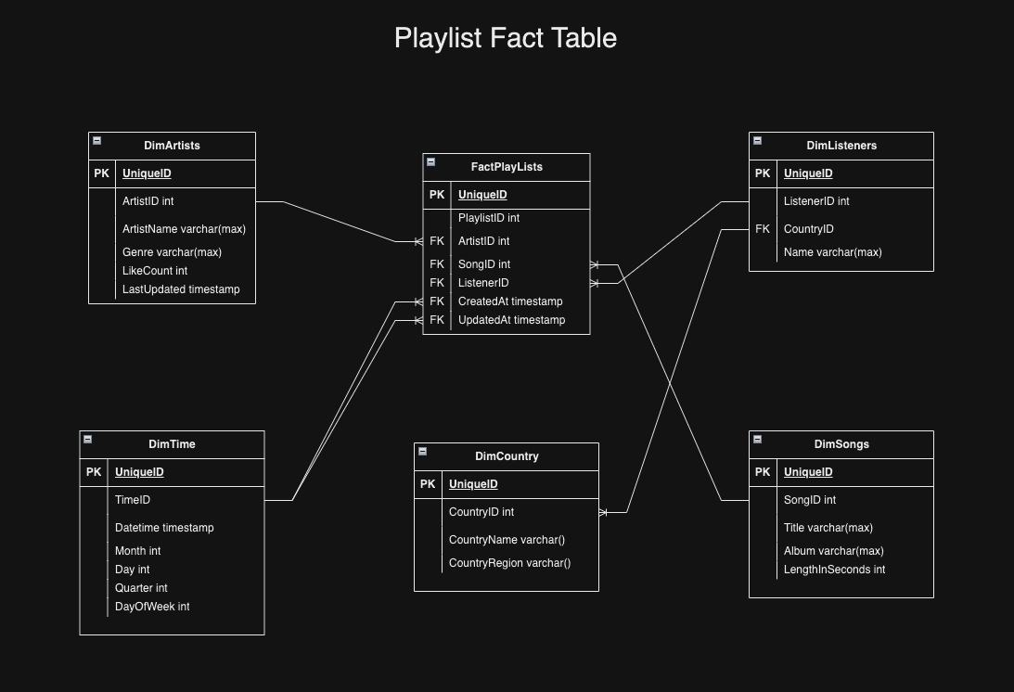
Tables

Slide 10
Part II

Slide 11
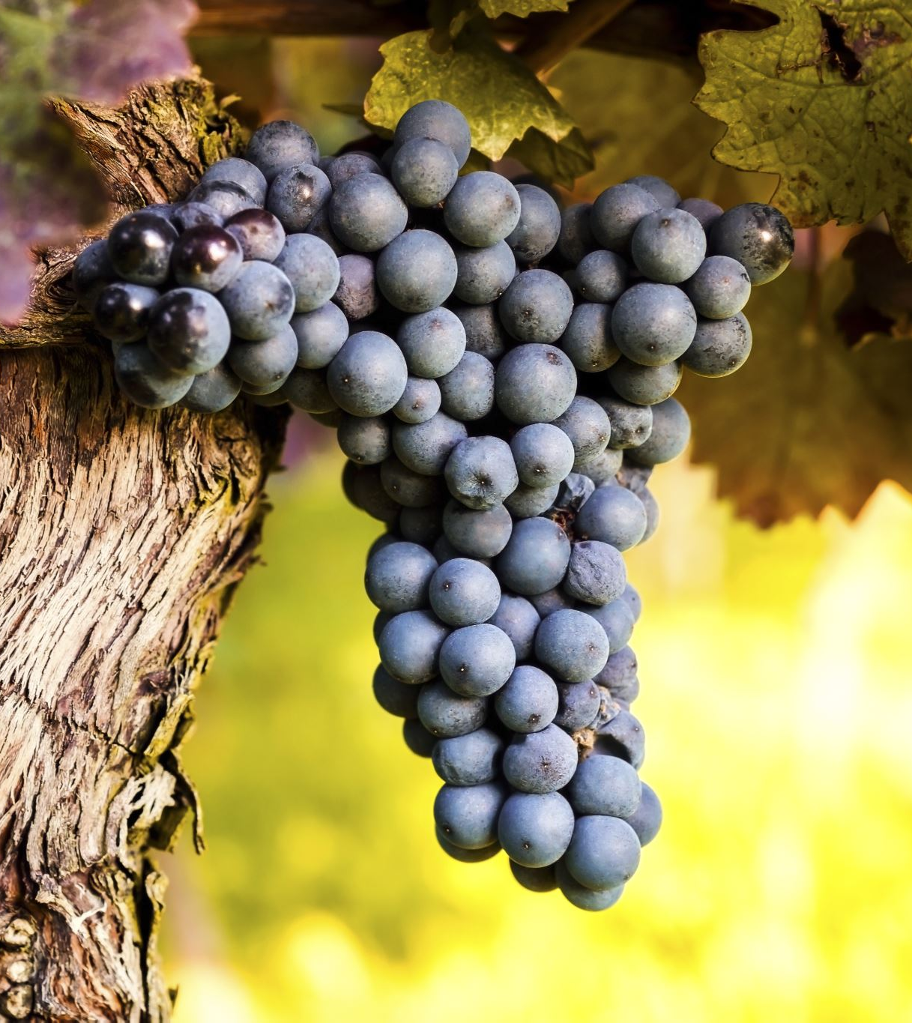
Overview
About the data. From UC Irving: “These data are the results of a chemical analysis of wines grown in the same region in Italy but derived from three different cultivars. The analysis determined the quantities of 13 constituents found in each of the three types of wines. ”
The dataset consists of one set for red and white data and is good for classification.
Included in my Github repo is the code that shows the combining of the two datasets, table creation in Snowflake and uploading combined data into Snowflake.
Exploratory analysis and feature selection is then performed.
The chosen features are then modeled and pushed to registry in Snowflake and an inference service serves this model in a Docker container.

Slide 12
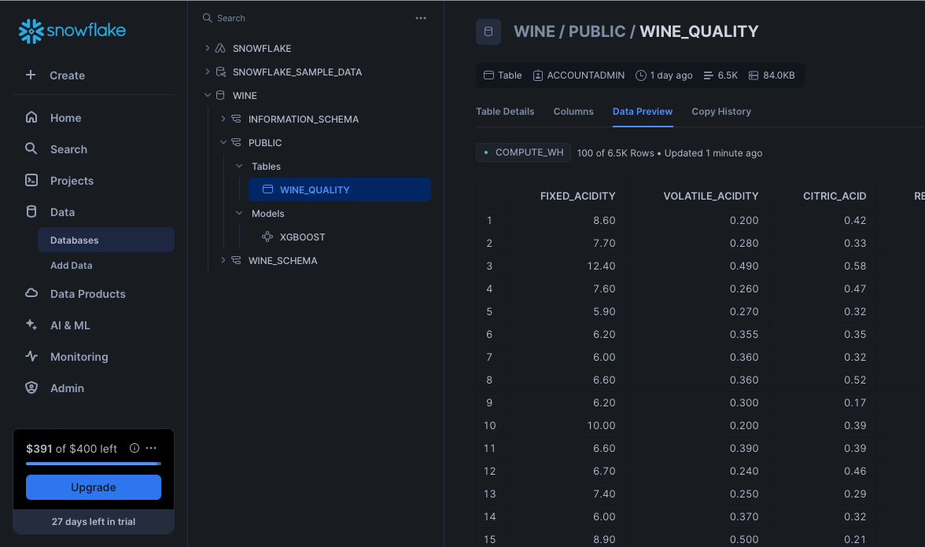
Data Engineering

Slide 13
Exploratory Analysis

Slide 14
Feature Selection

Slide 15
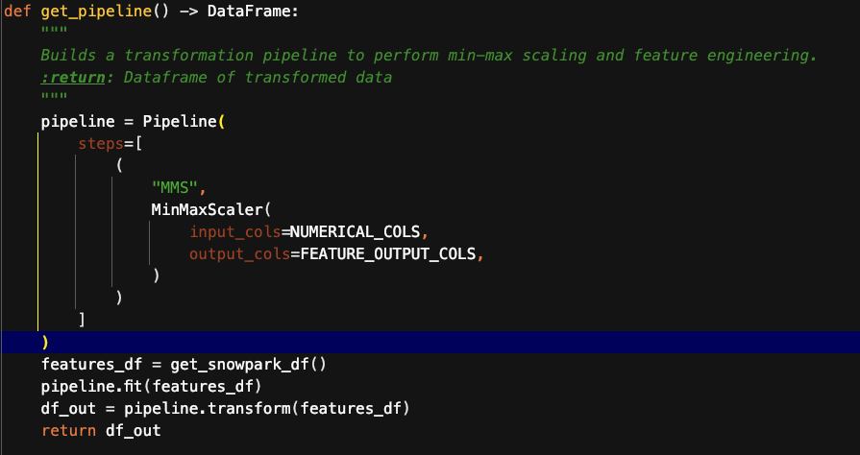
Feat. Eng. Pipeline

Slide 16
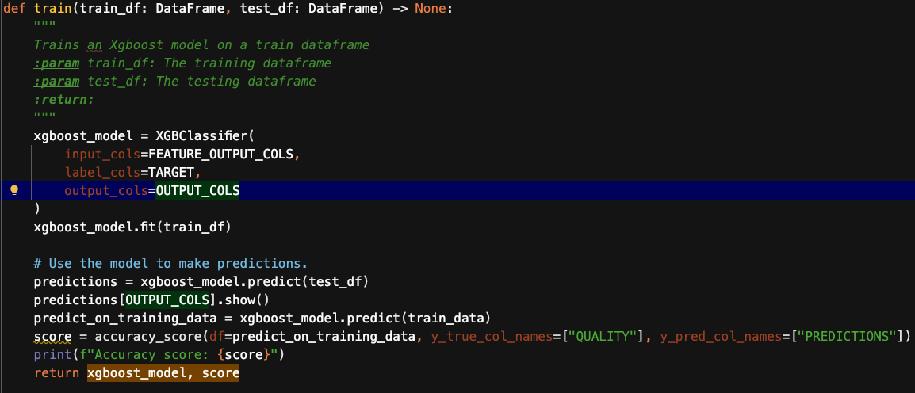
Model Pipeline

Slide 17
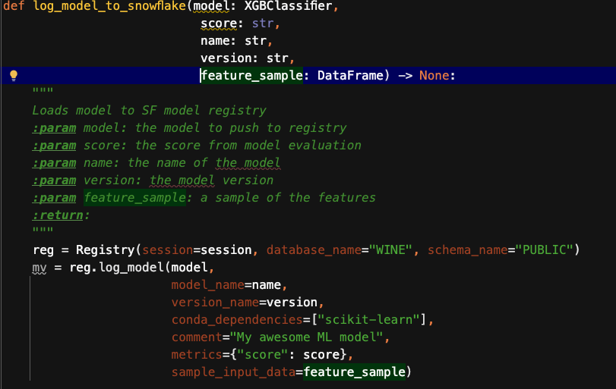
Model Repo

Slide 18
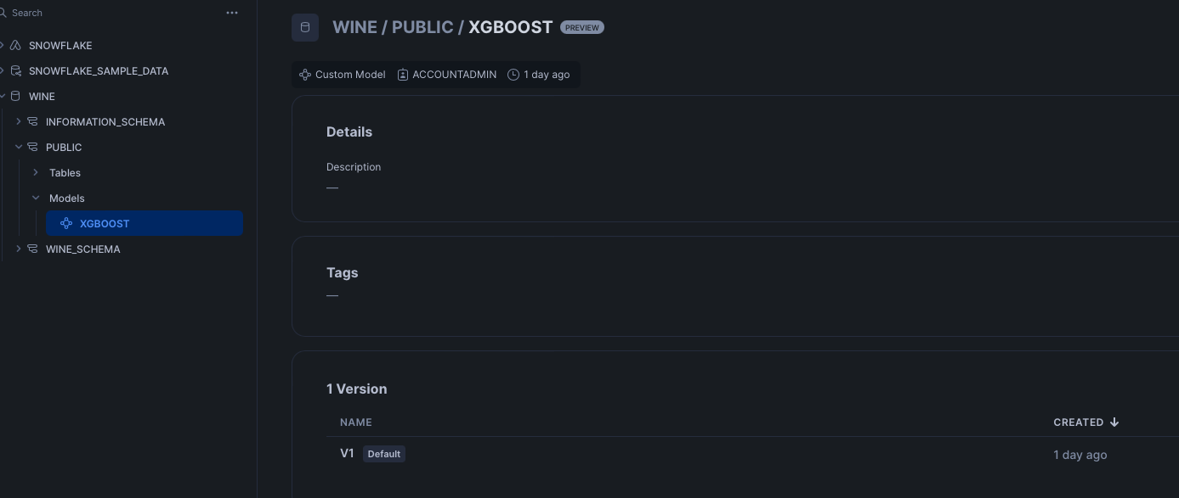
Model Repo

Slide 19
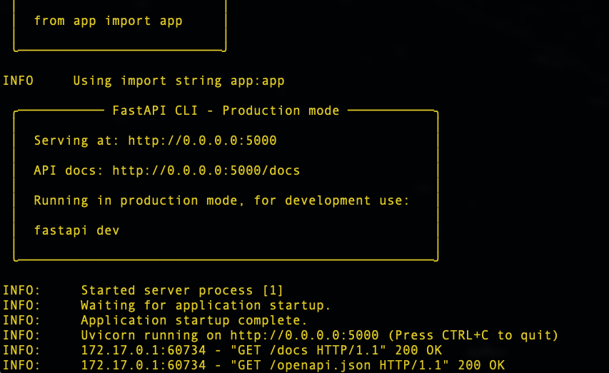
Inference Service

Slide 20
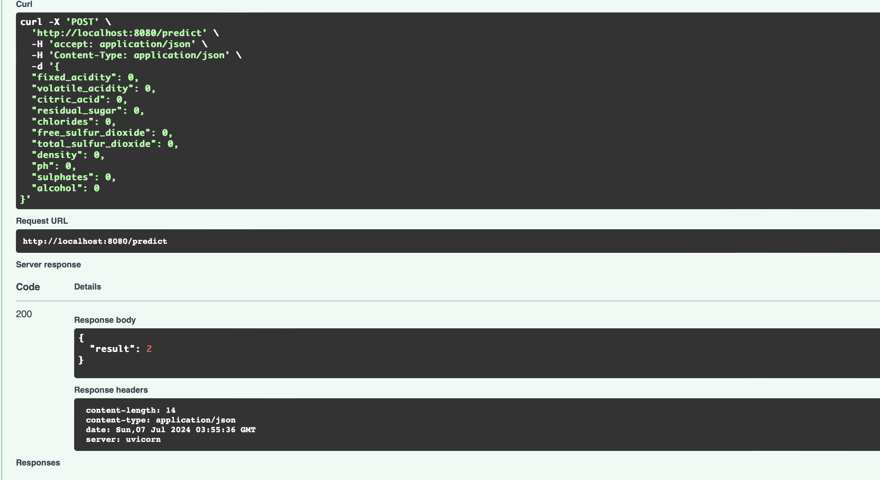
Inference Service

Slide 21
Additional Information

Slide 22
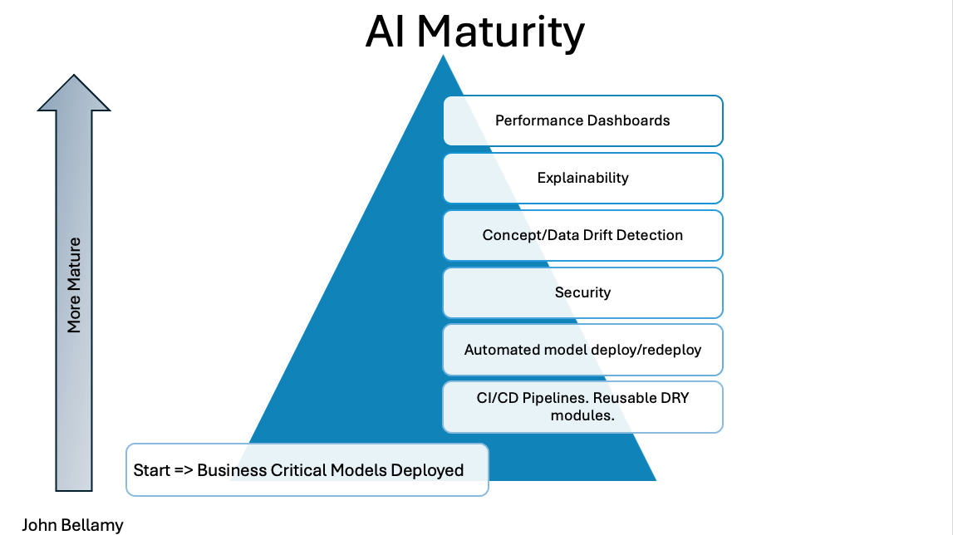
AI MATURITY

Slide 23
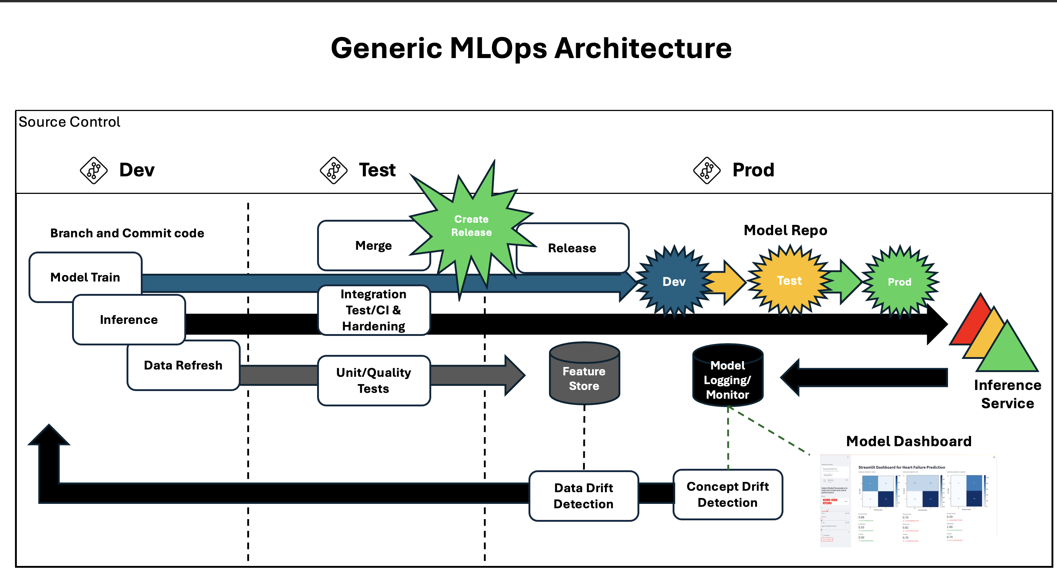
MLOps Arch

